Slide 1
DATA VISUALIZATION WITH TABLEAU

Slide 2
Hypothetical case
In 2016, the World Health Organization (WHO) reported that Obesity, Diabetes, and Blood Pressure are the three primary global health concerns.
In response to this information, the UK's National Health Service (NHS) decided to sort an analysis of the data to understand the situation of the country.

Slide 3
Date pre-processing
The data regarding ‘Prevalence of BMI>=30 kg/m≤ (obesity)’, ‘Prevalence of raised blood pressure’, and ‘Age-standardized diabetes prevalence’ was present in three different sheets. A ‘Union’ operation was done on the sheets to be able to use them for analysis.
The attributes of ‘Prevalence of BMI>=30 kg/m≤ (obesity)’, ‘Prevalence of raised blood pressure’, and ‘Age-standardized diabetes prevalence’ were converted to percentages and renamed as ‘BMI in %’, ‘BP in %’, and ‘Diabetes in %’ respectively.
An extra column of ‘Continents’ was added for refined analysis.

Slide 4
ANALYSIS 1 Analysis with single measurement: Prevalence of BMI>=30 kg/m≤ (obesity)

Slide 5
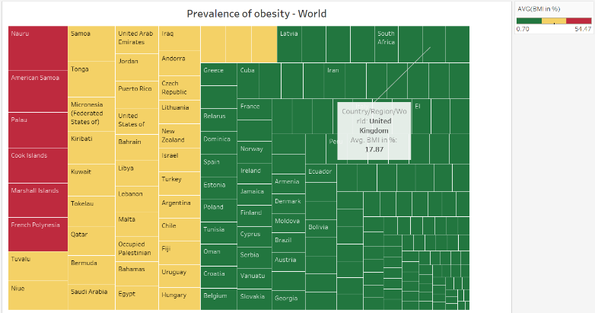
FINDING 1
A total of 6 countries falls under red zone.
Majority of the countries fall under green zone and hence have least prevalence of obesity.
UK falls under green zone. Hence, we can conclude that UK is safer, and the prevalence of Obesity is much lower in the UK when compared to other countries.

Slide 6
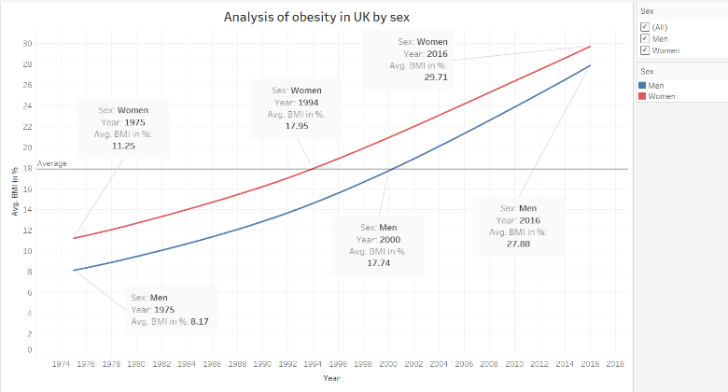
FINDING 2
Since 1975, women have shown higher obesity rates than men.
The prevalence of obesity in both the genders have risen constantly over the years.
The obesity rate in women went above the average from 1994 and that in men from 2000.

Slide 7
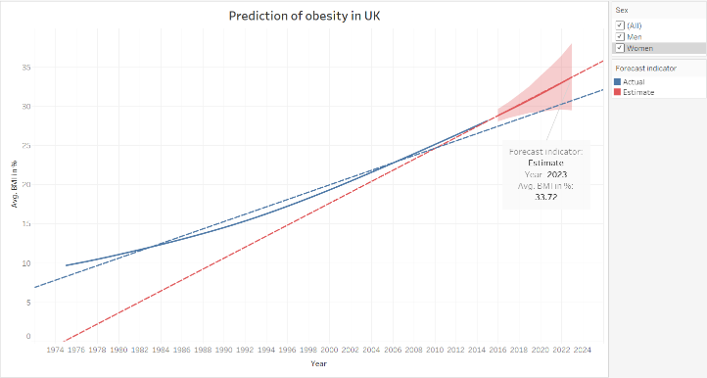
FINDING 3
It is estimated that the prevalence of obesity in the UK across sexes would increase to 33.72 % in the year 2023.
It is estimated that the prevalence of obesity in the UK for women would increase to 34.10% in the year 2023.
It is estimated that the prevalence of obesity in the UK for men would increase to 33.72 % in the year 2023.

Slide 8
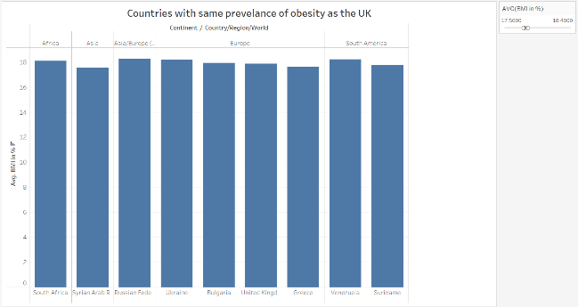
FINDING 4
Countries like South Africa, Syrian Arab Republic, Russian Federation, Bulgaria, Greece, Ukraine, Suriname, and Venezuela have the approximately 18% (rounded-off) of prevalence of obesity which is same as the UK.

Slide 9
ANALYSIS 2 Analysis with two or three measurements

Slide 10
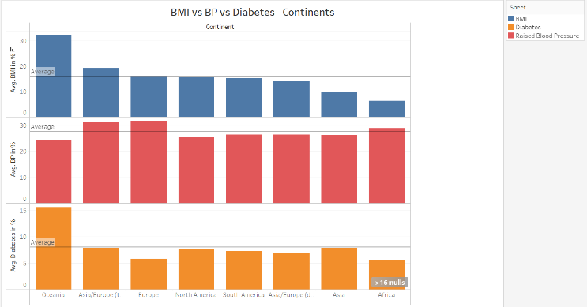
FINDING 5
Oceania shows an opposite behavior as compared to the other continents in the spread of BMI, BP and diabetes.
In Oceania, the BMI and diabetes are above the average level but the BP is below average level.

Slide 11
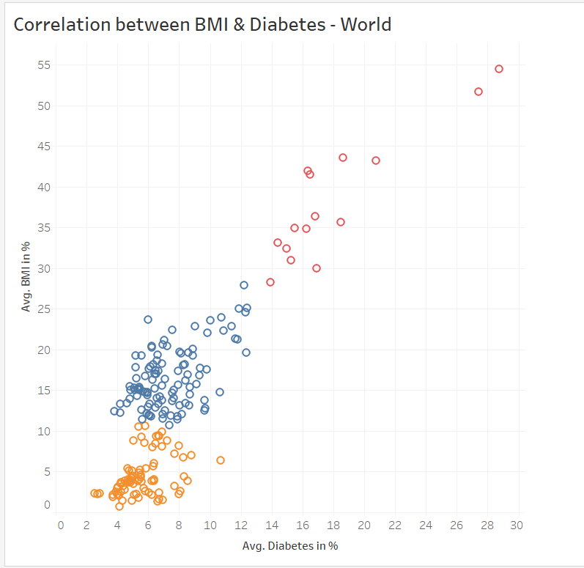
FINDING 6
There is a positive correlation in prevalence of obesity (BMI) and Diabetes across the world.
The countries were divided into 3 (using elbow method) clusters (as shown through different colors) and it was observed that distinct clusters were formed. This means that countries in each cluster behave similar.

Slide 12
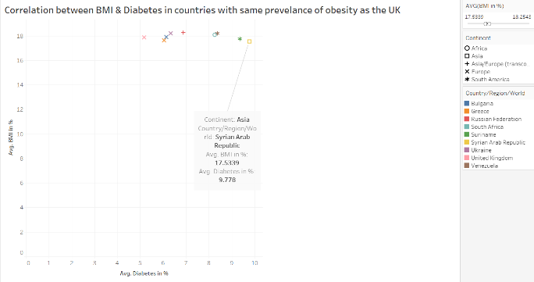
FINDING 7
There is little to no correlation between BMI and diabetes for the countries having similar prevalence of obesity (Finding 4) as that of the UK.

Slide 13
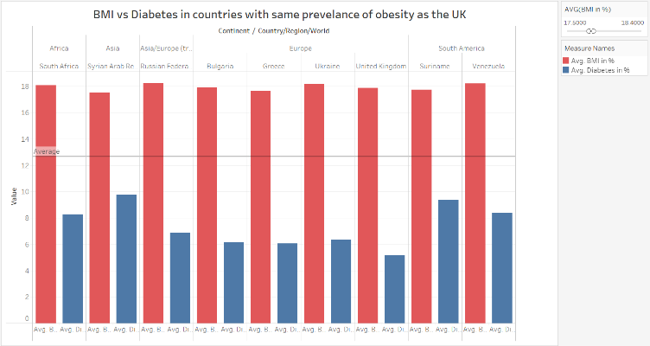
FINDING 8
For the countries sharing the similar obesity rates as that of the UK, the obesity rates have gone beyond the average values but the diabetes rates have always been below the average values.

Slide 14
THANK YOU

